Slide 1


Harnessing data to transform the power of molecular diagnostics and epidemiological modelling
Jesus Rodriguez Manzano, PhD
Lecturer in Antimicrobial Resistance and Infectious Disease at Imperial College London
Deputy Director of the Centre for Antimicrobial Optimisation (CAMO)

Slide 3
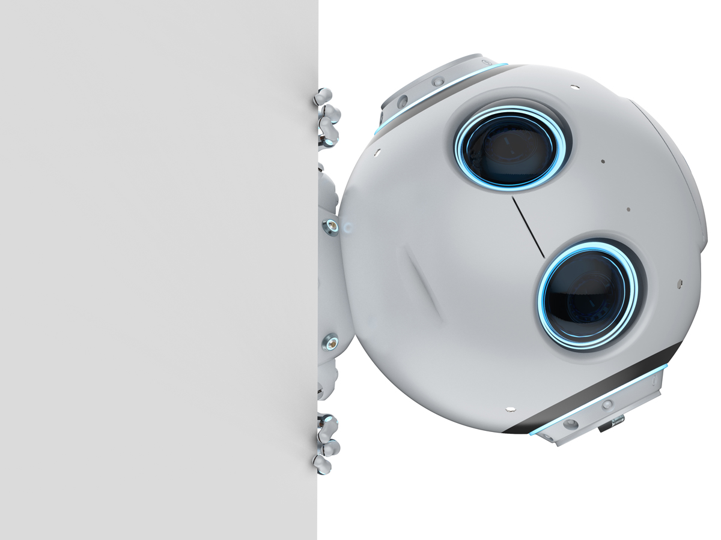
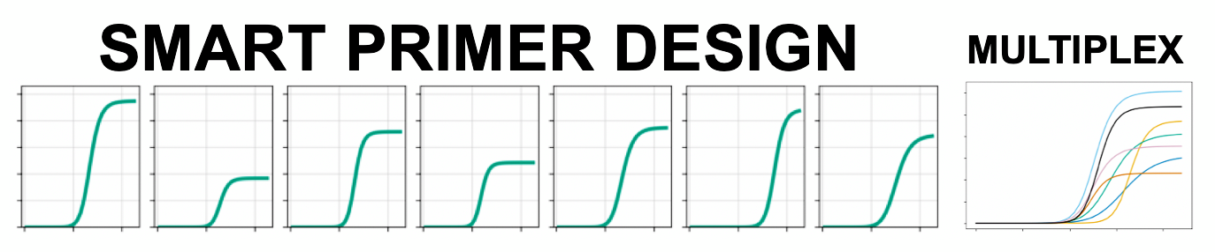
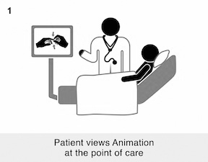




Data-driven multiplexing: concept
Maintain traditional qPCR workflow and instrumentation while streamlining data analysis and management
ML
Patient
Clinical sample
Genomics (DNA)
Molecular Test
Result
MOLECULAR DIAGNOSTIC PIPELINE
Patent reference numbers GB2108339.9 (2021), WO2022038279A1 (2020) and WO2019234247A1 (2018)

Slide 4
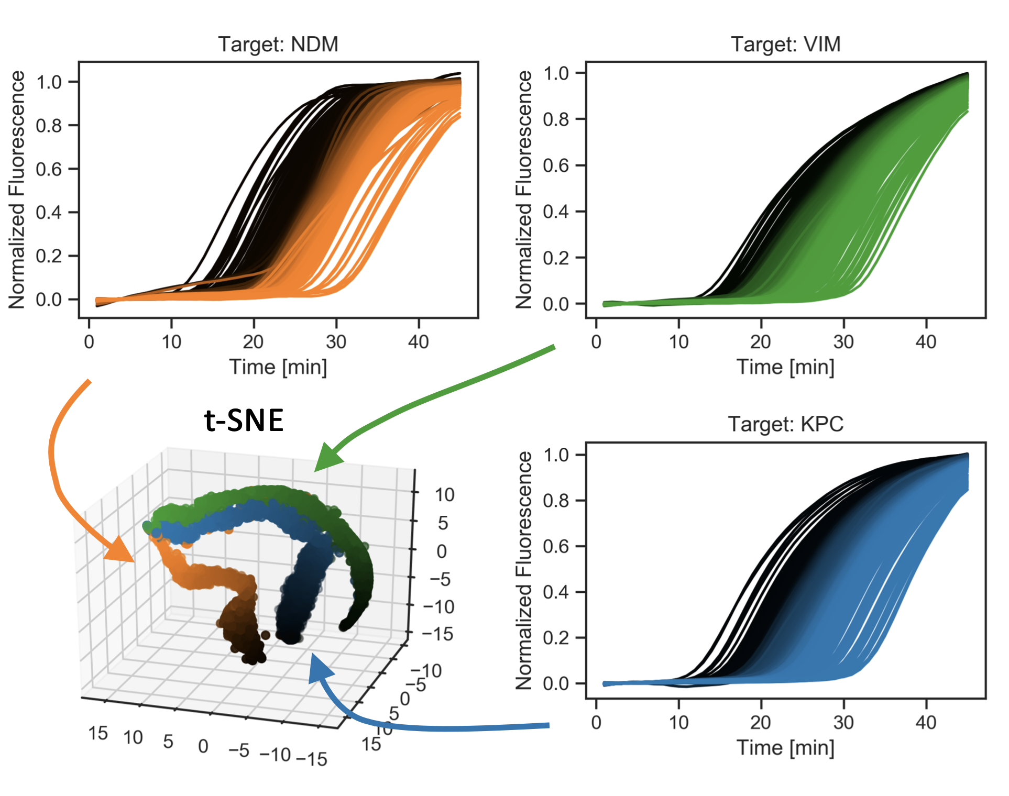
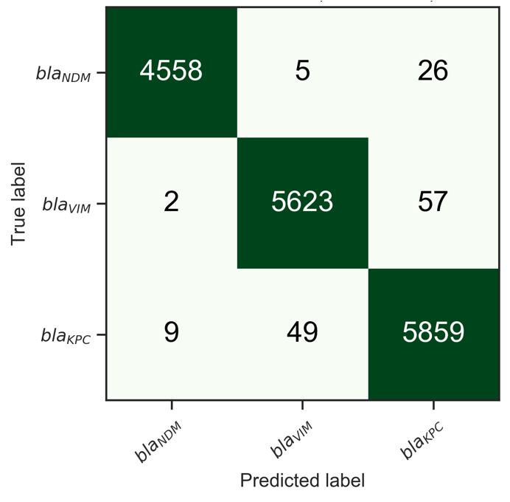
Data-driven multiplexing: how does it works?
Accuracy: 99.1%
(20% increase)

Slide 5
Amplification and melting curve analysis

Slide 6
Amplification and melting curve analysis

Slide 7

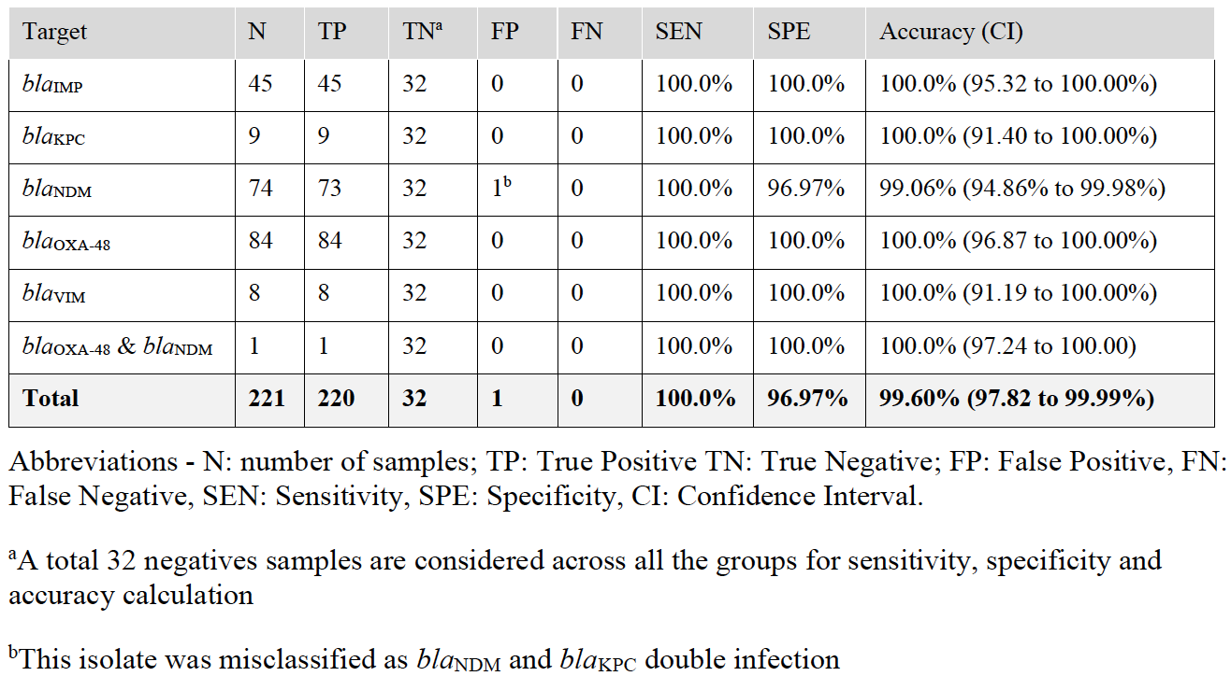
Data-driven multiplexing: CPE as case study
7-plex for respiratory pathogens using TaqMan probes & LAMP (Sensors & Diagnostics. 2022)
5-plex for CPE using Sybr green (Anal Chem. 2019 & Front Mol Biosci. 2021)
9-plex for mobilized colistin resistance genes using Sybr green (Anal Chem. 2020)

Slide 8








